Slide 1

Oconee County Fire Rescue: Paving the Digital Way
Prepared By:
Prepared For:
OCFR Executives
&
Professor Tom Gregory

Slide 2
AGENDA
01
05
02
06
03
07
04
08
Situation
Application Demo
Value Proposition
Business Justification
Current Scope, Time, Resources
Lessons Learned
Future Scope, Time, Resources
Conclusion

Slide 3
Situation | OCFR faces challenges concerning it’s current technological capabilities
About OCFR
What Happened?
The department wants an online system that tracks its members, contact information, and certification status
Building a full-stack web application
Volunteer organization in Oconee County, GA, with firefighters and rescue personnel

Slide 4
Value Proposition | Adding value through increased efficiency and business agility
Problems to Solve
Require multiple certifications for their work and tracking certifications
Has required greater FTE effort hours
Track members, their contact information, and current certification status
What to Achieve?
To help achieve organizational efficiency and agility through our software application
Software will relieve FTE hours
Providing scalable solution
Notes:
What problems are we trying to solve?:
Firefighters require multiple certifications for their work and tracking certifications and the certification status of member is nearly a full time job. Felicia Smoke has been manually tracking these and it has begun to take over her other responsibilities. Due to this, Oconee County Fire Rescue (OCFR) requires a custom software development project to track members, their contact information, and the current certification status of each of its current and former members to ease the burden on Ms. Smoke.
What are the business outcomes you want to achieve?:
We would like to help OCFR achieve organizational efficiency and agility through our software application by mitigating the county’s limited resources and IT personnel. As stated, this software will relieve Ms. Smoke of a FTE while providing a scalable solution for OCFR as well as fire departments in similar situations.

Slide 5
Current Scope, Time, and Resources |
What we currently have now
What Did We Achieve?
Schedule
Resources Required
Our team created a custom web application for your organization:
Deployed on a fully functioning cloud platform
Track status of current and former members
Multi-functional web page services
Mitigating limited IT personnel and resources
Exporting reports to CSV files
Open-source: for other departments that aim to develop similar applications in a common version control system.
Oct. 2 | Data Model Database, tables created
Oct. 9 | HTML Web templates
Oct. 16 | PHP/API Data access to SQL
Oct. 26 | VueJS Integration Web functionalities finished
Nov. 2 | Project Deadline
List of Resources:
Full-Stack Web Developer (x4) = $46 per hour
Atom IDE = Free
MySQL Notebook = Free
Amazon EC2 = $0.013 per hour
Time Required:
Full-Stack = 40 hours per week
Cloud = 84 hours per week
Total Cost (Until Now):
Full-Stack = $36,800
Cloud = $5.46

Slide 6
Future Scope, Time, and Resources |
What can it look like in the future
What Can We Achieve?
Schedule
Resources Required
For the future, our team aims to expand upon the functionalities and streamline current ones through:
Improved table grid filtering
Improved error handling and data validation capabilities
Improved and convenient edit and delete functionalities
Developing user login functionality
Nov. 5 | Table Grid Filter Column filtering
Nov. 10 | Data Validation Error handling for input forms
Nov. 15 | Edit/Delete Buttons For individual records
Nov. 20 | User Login Single sign-on service
List of Resources:
Full-Stack Web Developer (x4) = $46 per hour
Atom IDE = Free
MySQL Notebook = Free
Amazon EC2 = $0.013 per hour
Time Required:
Full-Stack = 40 hours per week
Cloud = 84 hours per week
Total Cost (Development & Support):
Full-Stack = $15,772
Cloud = $9.50 per month

Slide 7
Application Demo
EC2: Demo Link
Github Link

Slide 8
Justification | Why develop the technology stack we implement
Technology Stack
Full-stack web application that offers ease of use and convenient access to OCFR data
Through HTML & CSS, we provided a user-friendly UI
The application server connects to SQL through PHP, which retrieves the data to display on our web page and posts inputs from the website forms
As a team, we decided on contriving the aforementioned programming languages to produce a foolproof solution
Scalability and access to real time data
Employed SQL, PHP, and JSON to communicate between the different layers and seamless integration of data that is easily viewable to an end user to access via the OCFR website/portal
Notes:
We developed our technology stack in a way that offers ease of use and convenient access to OCFR data through an integration of varying programming languages. Through the use of HTML and CSS, we provided a user-friendly interface to view member information and track certifications. By consolidating this with SQL through the data layer, we can access member information as well as track it in real time. To present the data for our application, we implemented PHP, through the access layer, to connect to our MySql database and display it in a clear and efficient manner on our webpage executed through the use of JSON.

Slide 9
What Have We Learned?
01
Chintushig Gerelt-Od
The importance of a client-server architecture
Continuous integration
Organization is key in full-stack development
02
John Krieger
Debugging is an art form
The importance of using containers for development
Github is essential for a project of this magnitude
03
Sahil Patel
How to develop a basic full stack web application
Setting up an EC2 instance
The importance of debugging and use cases
04
Zara Lakehal-Ayat
Notes:
What did you learn as individuals (technical or other)? Each individual should provide substantive comment.

Slide 10
Thank you for your support
Please feel free to contact any of our team member’s to learn more about the custom web application

Slide 11
Appendix

Slide 12
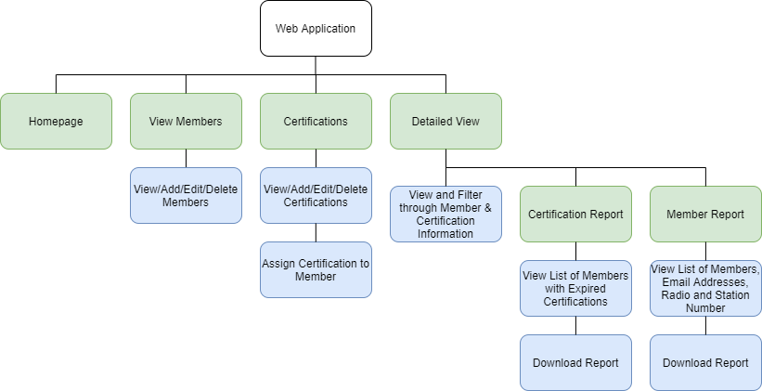
Appendix A: Site Map (Design)

Slide 13
Appendix B: User Stories
User Stories:
As a user I can easily navigate the website/application
As a user I can access information about OCFR current and former members
As a user I can view certifications and and see which members have those certifications
As a user I can view when certifications were acquired and when they expire
As a user I can add new members and certifications as well as edit and delete them
As a user I can view reports detailing active and expired certifications based on member name as well as a list of members by station, radio, and email address
Acceptance Criteria:
Website promotes ease of use and is intuitive to user
Show a member's name as well as identifying information
Display certifications associated with each member
Certification date acquired and expiration date are easily viewed
Provide options to add, edit, and delete information
Show reports detailing both members and certifications

Slide 14
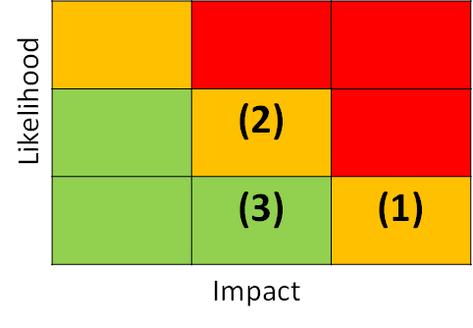
Appendix C: Risks & Mitigation
Risk | Likelihood | Impact | Mitigation
(1) Unexpected server downtime | Low | High | The AWS system is designed for quick data retrieval and backup; legacy systems can run in parallel
(2) Data breaches | Moderate | Moderate | As Personally Identifiable Information is stored, a single sign-on and multi-factor authentication functionalities should be developed
(3) Planned functionalities not achieved or developed | Low | Moderate | Our development team will provide support after the program goes live, and develop any remaining functionalities, if applicable

Slide 15
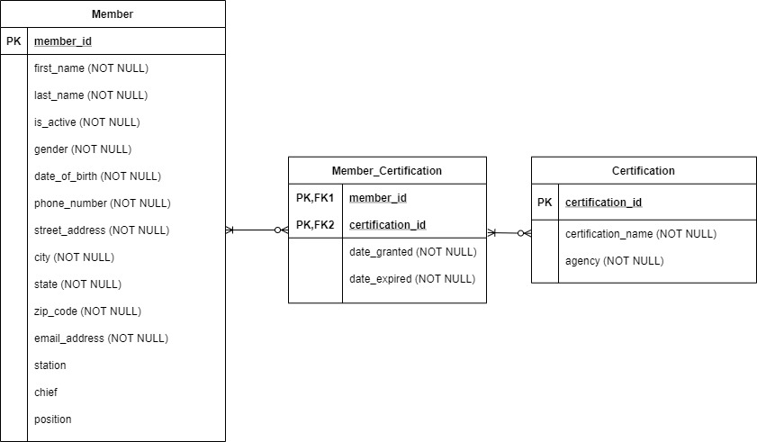
Appendix D: Data Model

